Slide 1
BUSINESS INSIGHTS 360
Presented by:
Janaki Patel

Slide 2
Problem Statement
AtliQ Hardware is a consumer goods electronics company having operations in various countries. Due to the lack of effective analytics the company faced a major loss in Latin America. Senior executives of this company have decided to invest in a data analytics project and have assigned a team for this work. Has decided to use PowerBi for the first time to execute data analytics.

Slide 3
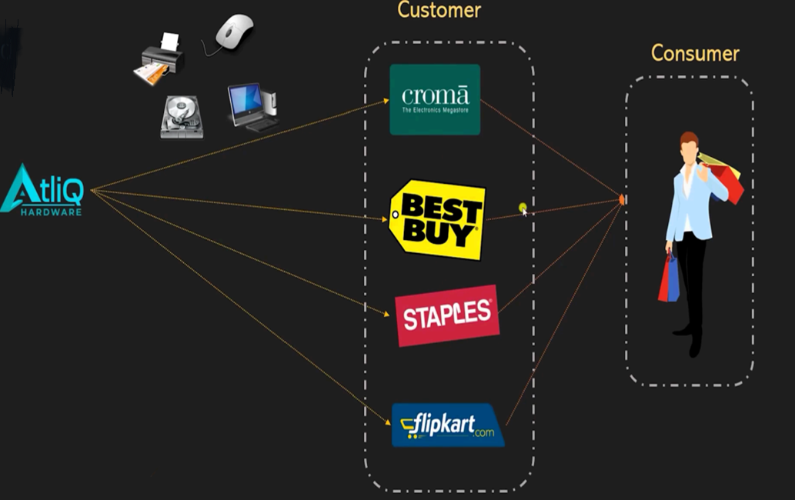
Regarding AtliQ and its Business model...
AtliQ Hardware, a dynamic player in computer hardware and peripherals, caters to major clients like Amazon, Flipkart, Neptune, Croma, and its own e-stores, utilizing various channels such as direct, retailer, and distribution.

Slide 4
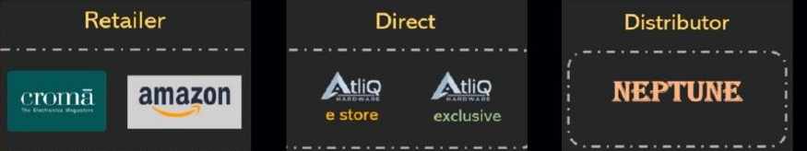
Channel

Slide 5
Data Source
SQL - gdb041
dim_customer , dim_market , dim_product , fact_forecast_monthly , fact_sales_monthly
SQL - gdb056
freight_cost , gross_price , manufacturing_cost , pre_invoice_deductions , post_invoice_deductions
Excel/ CSV Files
targets and market share

Slide 6
Business terms
Gross_price = Base price set for product.
Pre_invoice_deductions = Discount to customer set at the beginning of financial year.
Net Invoice sale = Gross price - Pre_invoice_deduction
Post_invoice_deductions = Details of post-invoice deductions and other deductions (Promotional offers, Placement fees and Performance Rebate)
Net Sales = Net Invoice sale - Post_invoice_deductions
COGS (Cost of Goods Sold) = Manufacturing cost + Freight cost (Transportation) + other cost
Gross Margin = Net Sales – COGS cost
Net Profit = Gross Margin – Operational Expenses
Net Error = Forecast Quantity– Actual Quantity
Abs Error = ABS(Net error)
Forecast Accuracy = 1 - Abs Error %

Slide 7
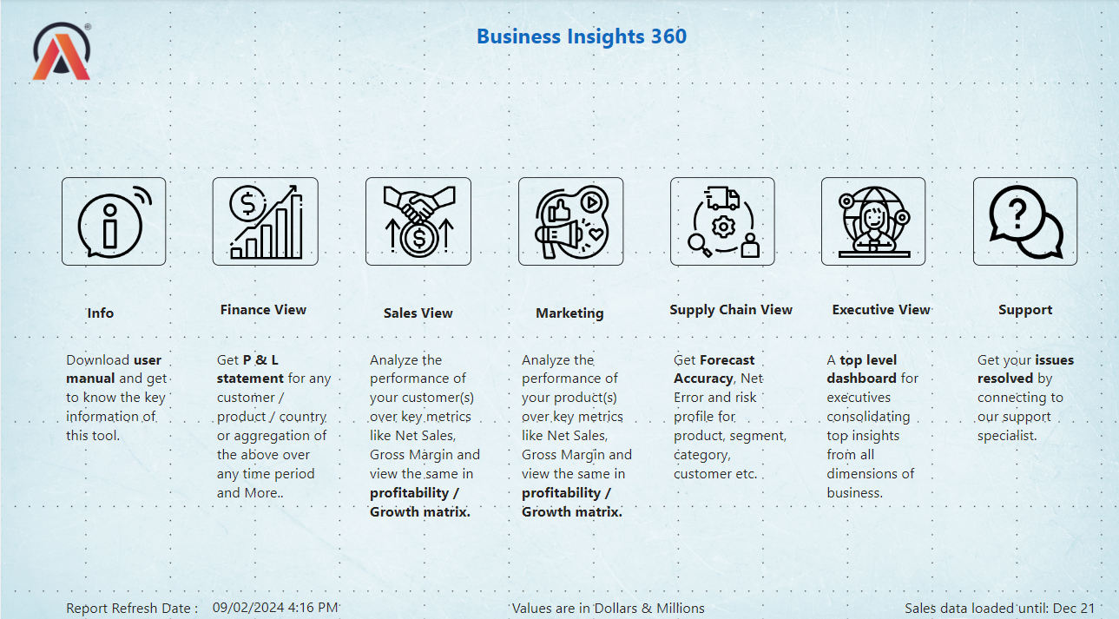
Home Page

Slide 8
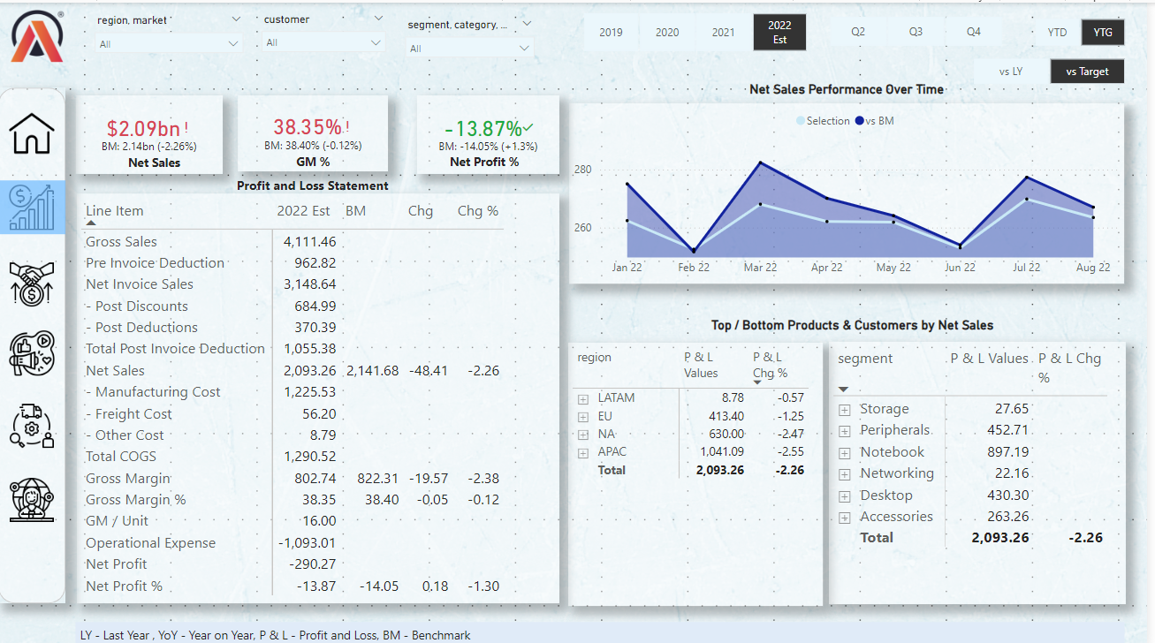
Finance View

Slide 9
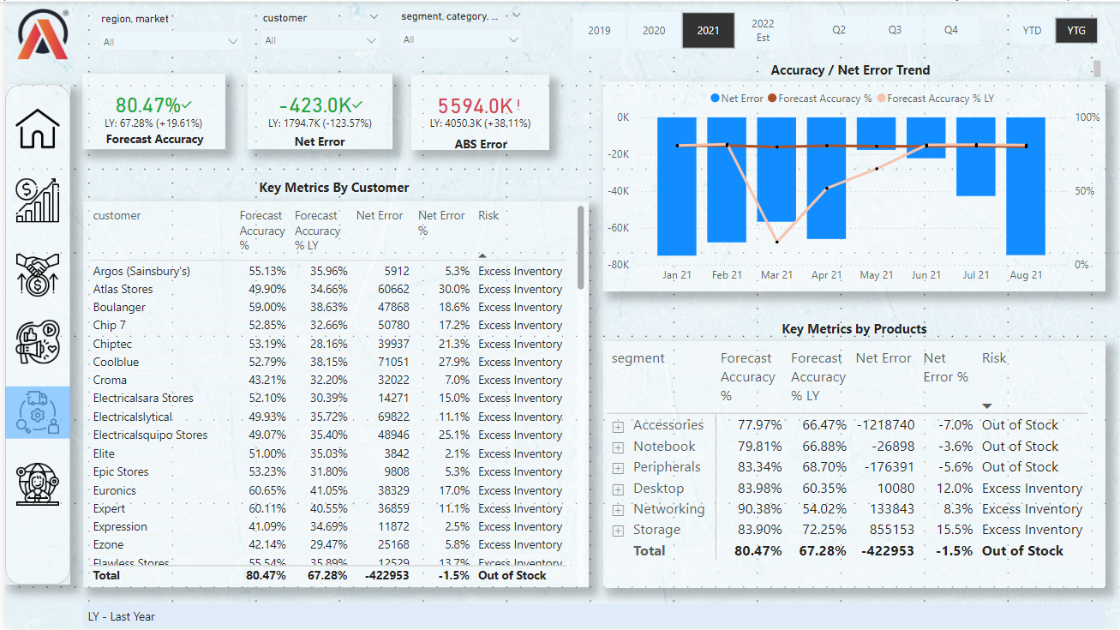
Supply Chain View

Slide 10
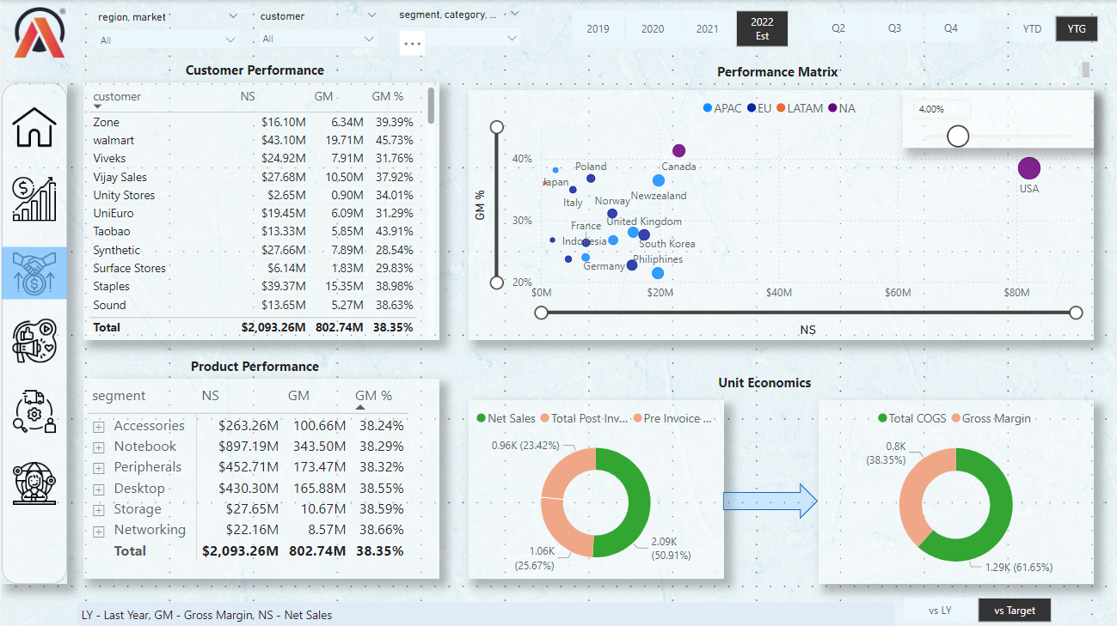
Sales View

Slide 11
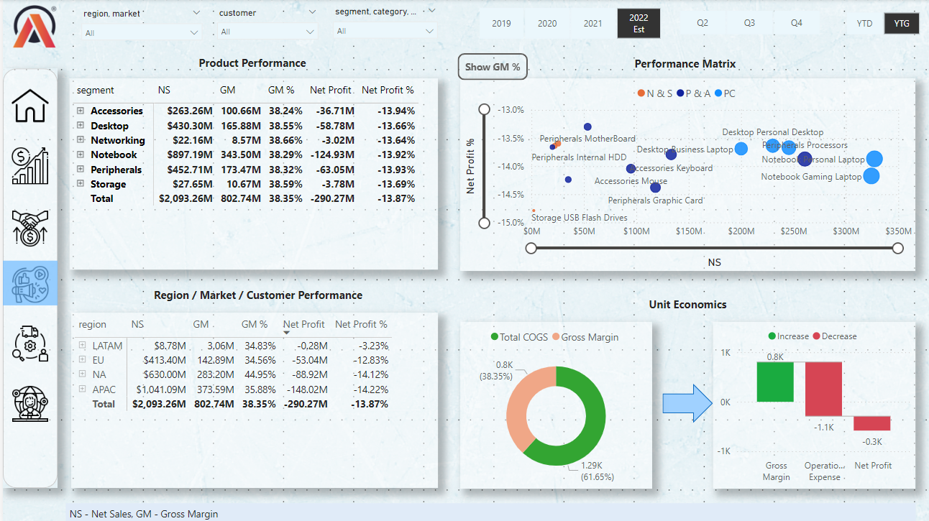
Marketing View

Slide 12
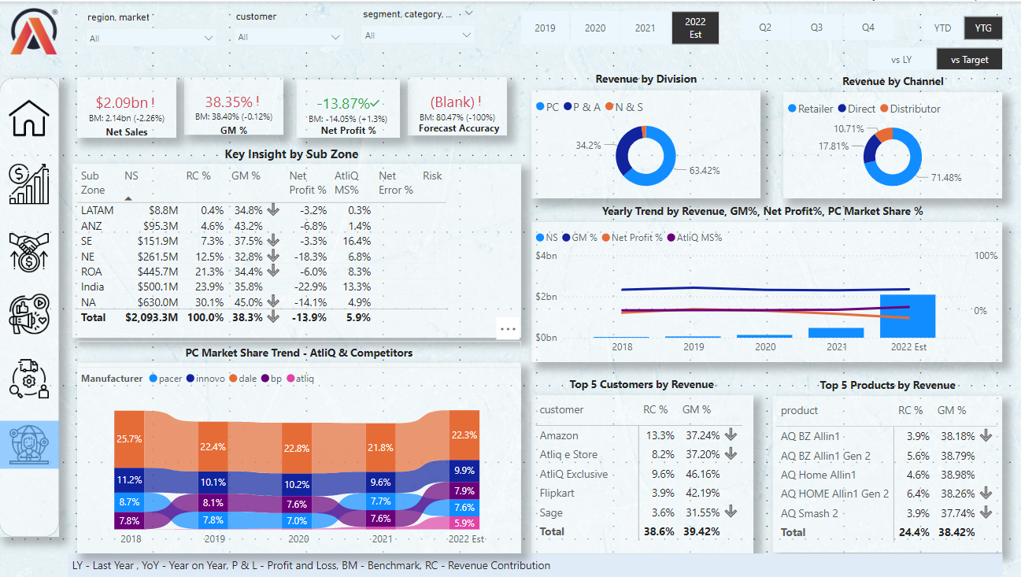
Executive View

